Slide 2
Learning Objectives (1 of 2)
Define e-commerce and describe its advantages, disadvantages, and business models
Explain the major categories of e-commerce
Describe the business-to-consumer e-commerce cycle
Summarize the major models of business-to-business e-commerce

Slide 3
Learning Objectives (2 of 2)
Describe mobile-based and voice-based e-commerce
Explain four supporting technologies for e-commerce
Explain social commerce and the reasons for its popularity
Explain hyper-social organizations and their growing popularity
Explain social media information systems

Slide 4
Defining E-Commerce (1 of 2)
E-business
All activities a company performs for selling and buying products and services using computers and communication technologies
E-commerce
Buying and selling goods and services over the Internet
Builds on traditional commerce by adding the flexibility that networks offer and the availability of the Internet

Slide 5
Defining E-Commerce (2 of 2)
Business applications
Buying and selling products and services
Collaborating with other companies
Communicating with business partners
Gathering business intelligence on customers and competitors
Providing customer service
Suppling software updates and patches
Offering vendor support
Publishing and disseminating information

Slide 6
The Value Chain and E-Commerce (1 of 2)
Value chain
Series of activities designed to meet business needs by adding value or cost in each phase of the process
Primary activities
Inbound logistics
Operations
Outbound logistics
Marketing and sales
Service

Slide 7
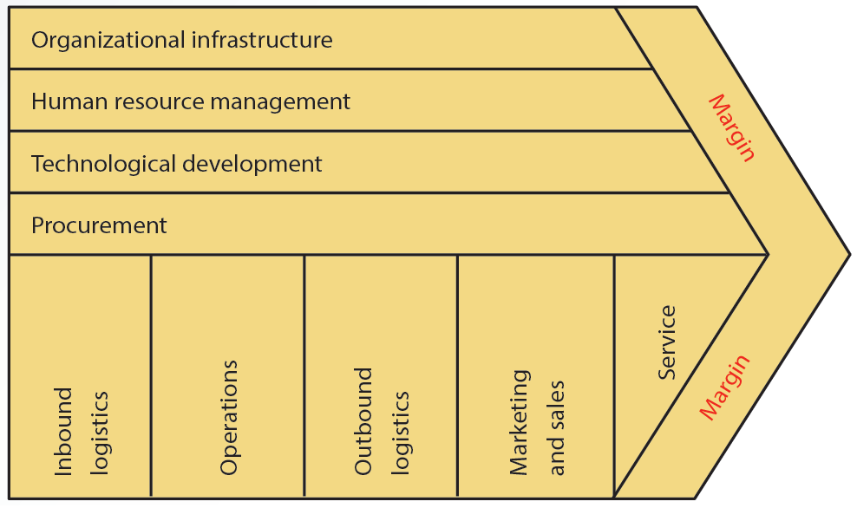
8.1 Michael Porter’s Value Chain

Slide 8
The Value Chain and E-Commerce (2 of 2)
The Internet
Increases the speed and accuracy of communication between suppliers, distributors, and customers
Low cost means companies of any size can participate in value chain integration
E-commerce enhances a value chain
Offers new ways to reduce costs or improve operations

Slide 9
E-Commerce vs. Traditional Commerce (1 of 2)
Click-and-brick e-commerce: mixes traditional commerce and e-commerce
Capitalizes on the advantages of online interaction with customers
Retains the benefits of having a physical store location

Slide 10
8.1 E-Commerce vs. Traditional Commerce (2 of 2)
Activity | Traditional Commerce | E-Commerce
Product information | Magazines, flyers | Web sites, online catalogs
Business communication | Regular mail, phone calls | E-mail
Check product availability | Phone calls, faxes, and letters | E-mail, Web sites, and extranets
Order generation | Printed forms | E-mail, Web sites
Product acknowledgments | Phone calls, faxes | E-mail, Web sites, and electronic data interchange (EDI)
Invoice generation | Printed forms | Web sites

Slide 11
Advantages and Disadvantages of E-Commerce (1 of 3)
Advantages
Enhances relationships with suppliers, customers, and business partners
Creates price transparency
Operates around the clock and globe
Gathers more information on potential customers
Increases customer involvement
Improves customer service

Slide 12
Advantages and Disadvantages of E-Commerce (2 of 3)
Increases flexibility, ease of shopping, number of customers, opportunities for collaboration with business partners, and return on investment
Offers personalized services and product customization
Reduces administrative and transaction costs

Slide 13
Advantages and Disadvantages of E-Commerce (3 of 3)
Disadvantages
Bandwidth capacity problems
Security and privacy issues
Accessibility
Acceptance

Slide 14
E-Commerce Business Models (1 of 4)
E-commerce companies focus their operations in different parts of the value chain to achieve profitability
Traditional e-commerce models are an extension or revision of traditional business models

Slide 15
E-Commerce Business Models (2 of 4)
Merchant model
Transfers the old retail model to the e-commerce world by using the Internet
Brokerage model
Brings sellers and buyers together on the Web and collects commissions on transactions between them

Slide 16
E-Commerce Business Models (3 of 4)
Advertising model
Extension of traditional advertising media
Directories such as Yahoo! provide content to users for free
Mixed model
Generating revenue from more than one source

Slide 17
E-Commerce Business Models (4 of 4)
Infomediary model
E-commerce sites collect information on consumers and businesses and then sell this information to other companies for marketing purpose
Subscription model
E-commerce sites sell digital products or services to customers

Slide 18
Major Categories of E-Commerce (1 of 4)
Business-to-consumer (B2C)
Companies sell directly to consumers and supplement traditional commerce with e-commerce
Business-to-business (B2B)
Involves electronic transactions between businesses, such as electronic data interchange (EDI) and electronic funds transfer (EFT)

Slide 19
Major Categories of E-Commerce (2 of 4)
Consumer-to-consumer (C2C)
Involves business transactions between users
Includes the use of online classified ads or online auction sites
Consumer-to-business (C2B)
Involves people selling products or services to businesses

Slide 20
Major Categories of E-Commerce (3 of 4)
Government and nonbusiness e-commerce
Government-to-citizen (G2C): tax filing
Government-to-business (G2B): license applications and renewals
Government-to-government (G2G): disaster assistance
Government-to-employee (G2E): e-training

Slide 21
Major Categories of E-Commerce (4 of 4)
Nonbusiness organizations that use e-commerce applications
Universities
Nonprofit organizations
Political and social organizations

Slide 22
Organizational or Intrabusiness E-Commerce
Involves e-commerce activities that take place inside an organization via the organization’s intranet
Exchange of goods, services, or information among employees
Conducting training programs and offering human resource services

Slide 23
B2C E-Commerce Cycle
Five major activities
Information sharing
Ordering
Payment
Fulfillment
Service and support

Slide 24
B2B E-Commerce: A Second Look
Technologies use
Intranets and extranets
Virtual private networks
Electronic data interchange (EDI)
Electronic funds transfer (EFT)
Advantages
Reduces delivery time and costs
Improves communication

Slide 25
Major Models of B2B E-Commerce
Models based on who controls the marketplace
Seller
Buyer
Intermediary (third party)
Trading partner agreements

Slide 26
Seller-Side Marketplace
Sellers who cater to specialized markets come together to create a common marketplace for buyers
E-procurement
Enables employees to order and receive supplies and services directly from suppliers
Prevents purchases from suppliers that are not on the approved list of sellers
Eliminates the processing costs of purchases

Slide 27
Buyer-Side Marketplace
Buyer, or a group of buyers, opens an electronic marketplace and invites sellers to bid
Helps buyers manage the procurement process more efficiently, lower administrative costs, and implement uniform pricing
Involves the goal of establishing new sales channels

Slide 28
Third-Party Exchange Marketplace
Marketplace generates revenue from the fees charged for matching buyers and sellers
Vertical market: concentrates on a specific industry or market
Horizontal market: concentrates on a specific function or business process and automates it for different industries
Offers suppliers a direct channel of communication to buyers

Slide 29
Trading Partner Agreements
Automate negotiating processes and enforce contracts between participating businesses
Allow business partners to send and receive bids, contracts, and information needed
Enable customers to submit documents via the Internet

Slide 30
Mobile and Voice-Based E-Commerce (1 of 2)
Mobile commerce (m-commerce): using handheld devices to conduct business transactions
Based on the Wireless Application Protocol (WAP)
Technologies supported
Wireless wide-area networks and 3G and 4G networks
Short-range wireless communication technologies

Slide 31
Mobile and Voice-Based E-Commerce (2 of 2)
Voice-based e-commerce: relies on voice recognition and text-to-speech technologies
Method involves using e-wallets
Virtual wallets
Security features
Call and voice recognition
Shipping to a set address that cannot be changed by voice commands

Slide 32
E-Commerce Supporting Technologies
Several technologies and applications support e-commerce activities
Electronic payment systems
Web marketing
Mobile marketing
Search engine optimization

Slide 33
Electronic Payment Systems (1 of 4)
Electronic payment
Money or script that is exchanged only electronically
Includes credit cards, debit cards, charge cards, and smart cards
Smart cards
Contain an embedded microprocessor chip
Store important financial and personal information

Slide 34
Electronic Payment Systems (2 of 4)
E-cash: secure and convenient alternative to bills and coins
Complements credit, debit, and charge cards
Adds convenience and control to everyday cash transactions
E-check: electronic version of a paper check
Offers security, speed, and convenience for online transactions

Slide 35
Electronic Payment Systems (3 of 4)
E-wallets: available for most handheld devices
Offer a secure, convenient, and portable tool for online shopping
Store personal and financial information
Paypal: popular online payment system used for many online transactions
Users with valid e-mail addresses can set up accounts and make secure payments

Slide 36
Electronic Payment Systems (4 of 4)
Micropayments: transactions on the web involving very small amounts of money
Began as a method for advertisers to pay for cost per view or cost per click

Slide 37
Web Marketing
Uses the Web and its supporting technologies to promote goods and services
Examples of web-marketing tools
Intelligent agents
Push technology

Slide 38
Mobile Marketing
Popular mobile marketing strategies
App-based marketing
In-game mobile marketing
Location-based marketing
QR codes
Mobile search ads
Mobile image ads
SMS (Short Message Service) and MMS (Multimedia Messaging Service)

Slide 39
Search Engine Optimization
Method for improving the volume or quality of traffic to a Web site
Higher ranking in search results generates more revenue for a website
Includes techniques facilitating search engines to find and index a site for certain keywords

Slide 40
E-Commerce and Beyond: Social Commerce (1 of 2)
Social media concentrates on insight and product discovery by providing a community of people with similar interests
Social commerce: subset of e-commerce that is influenced by social networks and other online media

Slide 41
E-Commerce and Beyond: Social Commerce (2 of 2)
Categories of social networks and online media that collectively constitute social commerce
Social networking sites
Group buying platforms
Peer-to-peer e-commerce platforms
Recommendation Web sites
Participatory e-commerce
Social advice
User-curated shopping

Slide 42
Hyper-Social Organizations (1 of 3)
Companies that leverage social media to better connect with customers and sell products and services
Share information through:
Direct social media interaction
Blogs
Videos on YouTube
Company Web sites

Slide 43
Hyper-Social Organizations (2 of 3)
Key elements for a successful online community
Members
Content
Member profiles
Transactions

Slide 44
Hyper-Social Organizations (3 of 3)
Pillars of hyper-sociality
Tribe versus market segment
Human-centric versus company-centric
Information channels versus network channels
Social messiness versus process hierarchy

Slide 45
Social Media Information Systems (1 of 3)
Include all the components like other information systems
Hardware, software, people, and procedures that support content sharing among its members or users
Application (app) providers
User communities
Sponsors

Slide 46
Social Media Information Systems (2 of 3)
Play a major role in fostering hyper-social organizations
Enable communities, tribes, or hives that are related by a common interest
Facilitate business activities and help the sponsors establish bonds and loyalties with their customers

Slide 47
Social Media Information Systems (3 of 3)
An organization’s social media policy should:
Protect the company’s reputation
Eliminate legal issues
Protect the privacy of all the impacted individuals
Raise brand awareness

Slide 48
Summary (1 of 2)
E-commerce is buying and selling goods and services over the internet
E-commerce transactions occur among consumers, businesses, and government
B2B e-commerce lowers production costs and improves accuracy by eliminating many labor-intensive tasks

Slide 49
Summary (2 of 2)
A number of technologies and applications support e-commerce activities
Social commerce is a subset of e-commerce that is influenced by social networks and other online media
Hyper-social organizations leverage the power of online communities
SMISs enable business activities such as sales and marketing for the sponsors

